Slide 1
Courier Management System
Team No: 33
Krishna Praneeth 2620090037
Paurush Sirohi 2620090004
CSIT • KLH Bachupally • Faculty Mentor: Dr Gopikrishna

Slide 2
Abstract
Project Summary
This project demonstrates a simple courier tracking system using Java.
It accepts a parcel ID and shows the route from Warehouse to Sorting Hub and Customer Address.
Users can move between stops, check status, and confirm whether delivery is successful.

Slide 3
Understanding Problem Statement
Problem Statement
Customers need a simple way to know where their parcel is during delivery.
The system displays the parcel route and current status.
Objectives: accept a parcel ID, update parcel status, check progress, and record DELIVERED or FAILED_DELIVERY.

Slide 4
Module 1: Java Foundations
Problem Solving and Java Basics
The problem is broken into steps: enter a parcel ID, track the route, and update delivery status.
Scanner reads user input, while variables store the current stop and status.
A String array stores the route, and operators and expressions support the program logic.

Slide 5
Module 2: Control Flow
Selection and Iteration
A while loop repeats the tracking menu until the user exits.
A switch statement handles actions such as moving to the next stop or checking status.
if-else checks delivery confirmation and updates the final status.

Slide 6
Module 3: Methods, Recursion & Arrays
Modular Programming and Arrays
The main() method is the program's entry point.
A one-dimensional String array stores the route: Warehouse, Sorting Hub, Customer Address.
The program uses an index to track the current stop; recursion and separate user-defined methods are not used in this version.

Slide 7
Module 4: OOP & Exception Handling
Classes, Objects and Error Handling
The program is organised in a Java class and uses the main() method.
Scanner is created as an object to read user input.
The current version does not implement inheritance, interfaces, encapsulation, or explicit try-catch exception handling.

Slide 8
Module 5: Strings, Algorithms & File I/O
String Handling and Input Validation
The parcel ID and delivery status are represented as Strings.
equalsIgnoreCase() can compare responses such as YES, yes, or Yes.
File reading/writing and library sorting or searching algorithms are not implemented in the current version.

Slide 9
Module 6: Collections, Lambdas & Streams
Collections and Functional Programming
The current program uses a String array to store the delivery route.
Collections such as ArrayList, HashMap, and HashSet could support tracking multiple parcels.
Lambdas and streams could be added later to filter parcels, sort records, or generate tracking summaries.

Slide 10
Conclusion
Conclusion
The project models a parcel's journey from registration to delivery.
It demonstrates arrays, loops, switch-case, and conditional statements in Java.
Future improvements could include multiple parcels, delivery-time estimates, and saving tracking history to a database.

Slide 11
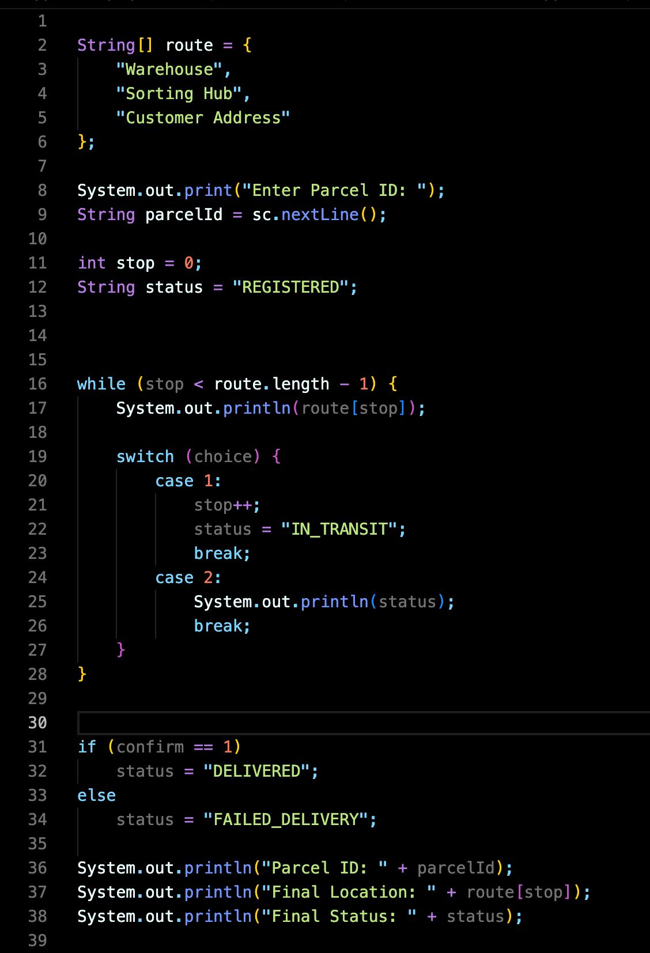
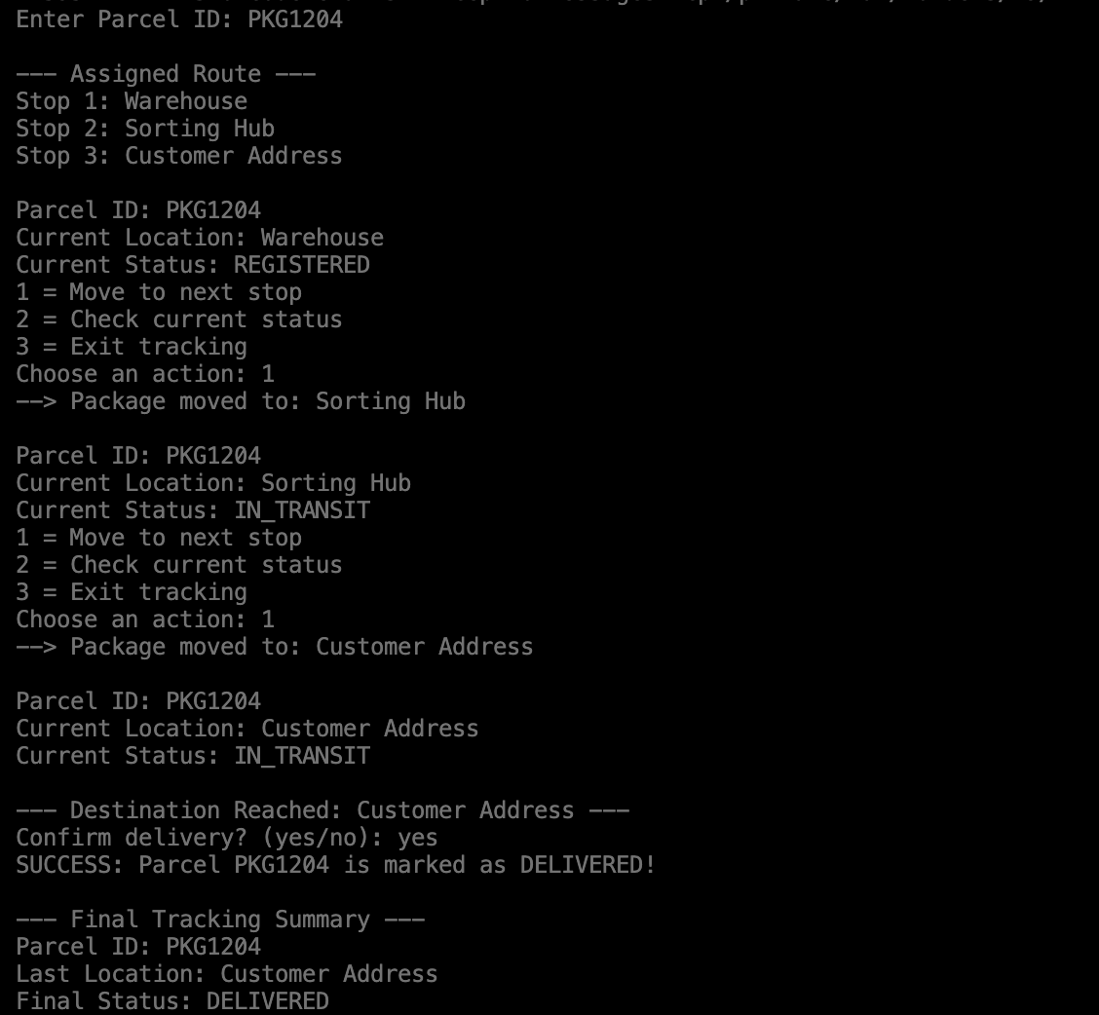
Screen Shots
CORE CODE
SAMPLE OUTPUT

Slide 12
Geo Tag Photo and GitHub Link
Github repo- https://github.com/PaurushSirohi/JAVA-PROJECT

